Slide 1
Data Structures Chapter 2-4
Performance Analysis
Big-O Notation
Big-O Properties
Growth Rates

Slide 2
다양한 변화율을 계산하고 비교할 수 있다

Slide 3
Agenda & Reading
Growth Rate
Comparison
Profiling and Prediction

Slide 4
Helper function: range(n)
std::vector<int> range(int n)
returns a sequence of numbers from 0 to n – 1 in vector<int>
#include <vector>
#include <iostream>
std::vector<int> range(int n) {
std::vector<int> result;
for (int i = 0; i < n; ++i)
result.push_back(i);
return result;
}
int main() {
for (auto num: range(5))
std::cout << num << " ";
return 0;
}
0 1 2 3 4

Slide 5
Helper function: range(start, stop, step=1)
std::vector<int> range(int start, int stop, int step = 1)
returns a sequence of numbers from start to stop – 1 with step
#include <vector>
#include <iostream>
std::vector<int> range(int start, int stop, int step = 1) {
std::vector<int> result;
if (step > 0) {
for (int i = start; i < stop; i += step)
result.push_back(i);
} else {
for (int i = start; i > stop; i += step)
result.push_back(i);
}
return result;
}

Slide 6
Helper function: ctime_in_sec()
double ctime_in_sec() returns the current time in seconds
#include <iostream>
using namespace std;
using namespace chrono;
double ctime_in_sec() {
auto currentTime = system_clock::now();
auto duration = currentTime.time_since_epoch();
return duration_cast<milliseconds>(duration).count() / 1000.0;
}
int main() {
double startTime = ctime_in_sec();
// your code here
double endTime = ctime_in_sec();
double elapsedTime = endTime - startTime;
cout << "Elapsed time: " << elapsedTime << " seconds" << endl;
return 0;
}

Slide 7

1 Growth Rate Comparison - Hypothetical Running Time
The running time on a hypothetical computer that computes ${10}^{6}$operations per second for varies problem sizes
$$O(1) < O(log⁡n) < O(n) < O(n log⁡n) < O(n2) < O(n3) < O(2n)$$
Notation |  |  | n = 10 | n = 10² | n = 10³ | n = 10⁴ | n = 10⁵ | n = 10⁶
O(1) | Constant | 상수 | 1 µsec | 1 µsec | 1 µsec | 1 µsec | 1 µsec | 1 µsec
O(log(n)) | Logarithmic | 대수 함수 | 3 µsec | 7 µsec | 10 µsec | 13 µsec | 17 µsec | 20 µsec
O(n) | Linear | 선형 함수 | 10 µsec | 100 µsec | 1 msec | 10 msec | 100 msec | 1 sec
O(nlog(n)) | N log N | 선형 대수 함수 | 33 µsec | 664 µsec | 10 msec | 13.3 msec | 1.6 sec | 20 sec
O(n²) | Quadratic | 2차 함수 | 100 µsec | 10 msec | 1 sec | 1.7 min | 16.7 min | 11.6 days
O(n³) | Cubic | 3차 함수 | 1 msec | 1 sec | 16.7 min | 11.6 days | 31.7 years | 31709 years
O(2^{n}) | Exponential | 지수 함수 | 10 msec | 3e17 years

Slide 8
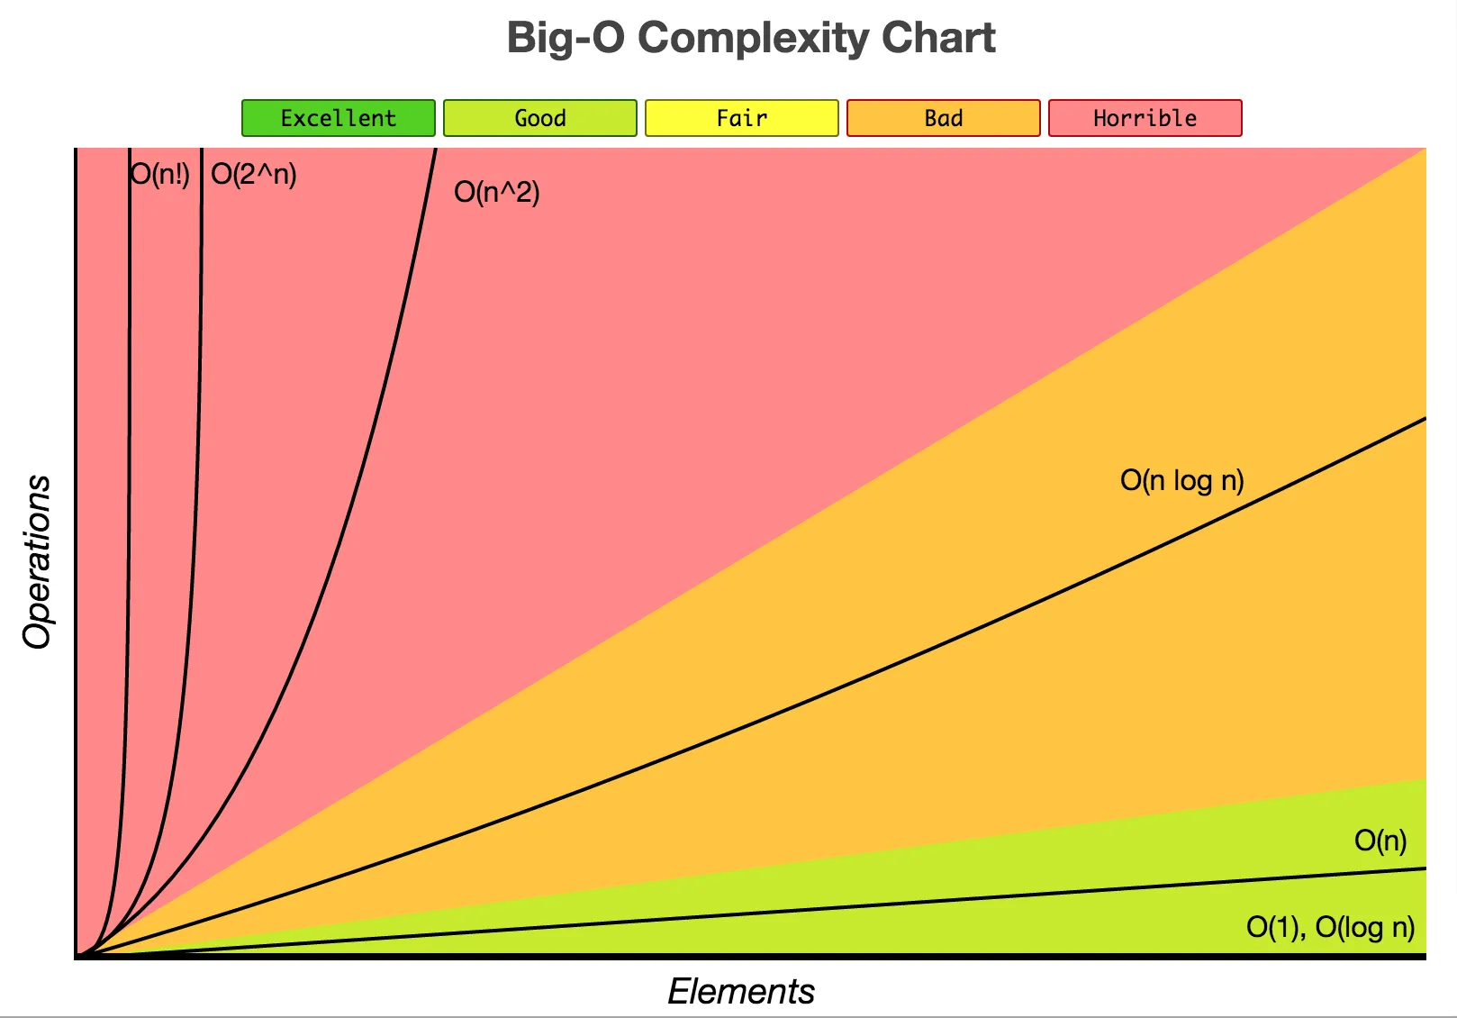
1 Growth Rate Comparison
$$O(1) < O(log⁡n) < O(n) < O(n log⁡n) < O(n2) < O(n3) < O(2n)$$
A comparison of growth-rate functions in graphical form

Slide 9
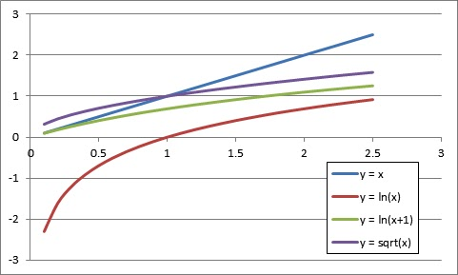

1 Growth Rate Comparison
$$O(1) < O(log⁡n) < O(n) < O(n log⁡n) < O(n2) < O(n3) < O(2n)$$
$T\left(N\right)≈ aN^{b}$
A comparison of growth-rate functions in graphical form

Slide 10
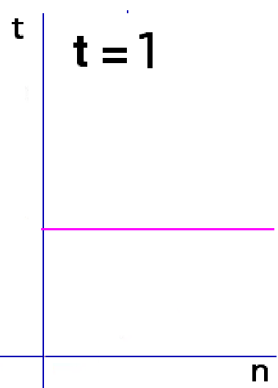
2 Growth Rate Examples - Constant Growth Rate - O(1)
Time requirement is constant and, therefore, independent of the problem’s size n.
void rate1(n) {
s = "SWEAR";
for (auto i: range(25))
cout << "I must not " << s;
}
n | 10¹ | 10² | 10³ | 10⁴ | 10⁵ | 10⁶
O(1) | 1 | 1 | 1 | 1 | 1 | 1

Slide 11
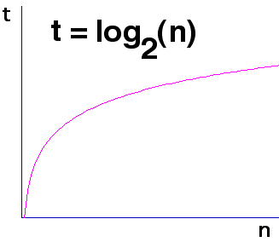
2 Growth Rate Examples - Logarithmic Growth Rate - O(log n)
Increase slowly as the problem size increases.
If you square the problem size, you only double its time requirement.
The base of the log does not affect a log growth rate, so you can omit it.
void rate2(n) {
s = "YELL";
i = 1;
while (i < n) {
cout << "I must not " << s;
i = i * 2;
}
}
n | 10¹ | 10² | 10³ | 10⁴ | 10⁵ | 10⁶
O(log₂ n) | 3 | 6 | 9 | 13 | 16 | 19

Slide 12
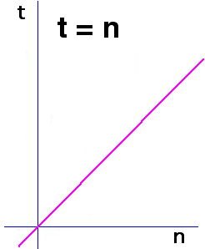
2 Growth Rate Examples - Linear Growth Rate - O(n)
The time increases directly with the sizes of the problem.
If you square the problem size, you also square its time requirement.
void rate3(n) {
s = "FIGHT"
for (auto i: range(n))
cout << "I must not " << s;
}
n | 10¹ | 10² | 10³ | 10⁴ | 10⁵ | 10⁶
O(n) | 10 | 10² | 10³ | 10⁴ | 10⁵ | 10⁶

Slide 13
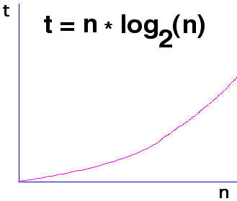
2 Growth Rate Examples - n* log n Growth Rate - O(n log(n))
The time requirement increases more rapidly than a linear algorithm.
Such algorithms usually divide a problem into smaller problem that are each solved separately.
void rate4(n):
s = "HIT";
for (auto i: range(n)) {
j = n;
while (j > 1) {
cout << "I must not " << s;
j = j // 2;
}
}
n | 10¹ | 10² | 10³ | 10⁴ | 10⁵ | 10⁶
O(nlog(n)) | 30 | 664 | 9965 | 10⁵ | 10⁶ | 10⁷

Slide 14
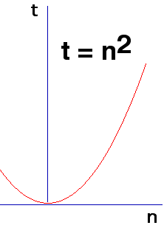
2 Growth Rate Examples - Quadratic Growth Rate - O(n²)
The time requirement increases rapidly with the size of the problem.
Algorithms that use two nested loops are often quadratic.
void rate5(n) {
s = "LIE"
for (auto i: range(n))
for (auto j: range(n))
cout << "I must not " << s;
}
n | 10¹ | 10² | 10³ | 10⁴ | 10⁵ | 10⁶
O(n²) | 10² | 10⁴ | 10⁶ | 10⁸ | ₁₀10 | ₁₀12

Slide 15
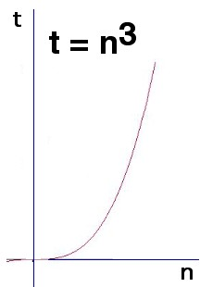
2 Growth Rate Examples - Cubic Growth Rate - O(n³)
The time requirement increases more rapidly with the size of the problem than the time requirement for a quadratic algorithm.
Algorithms that use three nested loops are often quadratic and are practical only for small problems.
void rate6(n) {
s = "SPACE OUT IN CLASS";
for (auto i: range(n))
for (auto j: range(n))
for (auto k: range(n))
cout << "I must not " << s;
}
n | 10¹ | 10² | 10³ | 10⁴ | 10⁵ | 10⁶
O(n³) | 10³ | 10⁶ | 10⁹ | ₁₀12 | ₁₀15 | ₁₀18

Slide 16
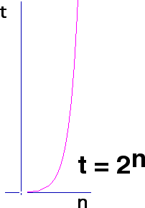
2 Growth Rate Examples - Exponential Growth Rate - O(2^{n})
As the size of a problem increases, the time requirement usually increases too rapidly to be practical.
void rate7(n) {
s = "ZONE OUT IN CLASS";
for (auto i: range(2 ** n))
cout << "I must not " << s;
}
n | 10¹ | 10² | 10³ | 10⁴ | 10⁵ | 10⁶
O(2^{n}) | 10³ | ₁₀30 | ₁₀301 | ₁₀3010 | ₁₀30103 | ₁₀301030

Slide 17
Exercise
What is the Big-O of the following statements?
Running time, T(n) = n * 10 * 1 = 10n, Big-O =
What is the Big-O of the following statements? Big-O =
The first set of nested loops is O(n²) and the second loop is O(n). This is O(max(n²,n)) Big-O =
for (auto i: range(n))
for (auto j: range(10))
cout << i << ' ' << j;
executed n times
executed 10 times
constant time
for (auto i: range(n))
for (auto j: range(n))
cout << i << ' ' << j;
for (auto k: range(n))
cout << k;
executed n times
executed n times
executed n times

Slide 18
Exercise
What is the Big-O of the following statements?
Running time, T(n) = n * 10 * 1 = 10n, Big-O = O(n)
What is the Big-O of the following statements? Big-O =
The first set of nested loops is O(n²) and the second loop is O(n). This is O(max(n²,n)) Big-O = O(n²)
for (auto i: range(n))
for (auto j: range(10))
cout << i << ' ' << j;
executed n times
executed 10 times
constant time
for (auto i: range(n))
for (auto j: range(n))
cout << i << ' ' << j;
for (auto k: range(n))
cout << k;
executed n times
executed n times
executed n times

Slide 19
Quiz
What is the Big-O of the following statements?
When i is 0, the inner loop executes (n - 1) times. When i is 1, the inner loop executes (n – 2) times. … When i is (n – 2), the inner loop executes once.
The number of times the inner loop statements execute:
Running time, T(n) =
Big-O =
for (auto i: range(n))
for (auto j: range(i+1, n))
cout << i << ' ' << j;

Slide 20
Quiz
What is the Big-O of the following statements?
When i is 0, the inner loop executes (n - 1) times. When i is 1, the inner loop executes (n – 2) times. … When i is (n – 2), the inner loop execute once.
The number of times the inner loop statements execute:
Running time, T(n) = (n - 1) + (n - 2) ... + 2 + 1 = n * (n – 1) / 2
Big-O = O(n²)
for (auto i: range(n))
for (auto j: range(i+1, n))
cout << i << ' ' << j;

Slide 21

3 Profiling: Measuring Growth Rate
Problem: Predict the running time of a big data set (i.e., n = 1 million or 1 billion).
Most algorithms approximately have the order of growth of the running time: $T\left(N\right)≈ aN^{b}$
For example, we may compute the constant "a" and the growth rate "b" from data we got from profiling (i.e., performance analysis) as shown below.
N sec
1000 0.000770
2000 0.002855
3000 0.006579
4000 0.011144
5000 0.014565
6000 0.023295
7000 0.028571
8000 0.036643
9000 0.047810
10000 0.063062

Slide 22
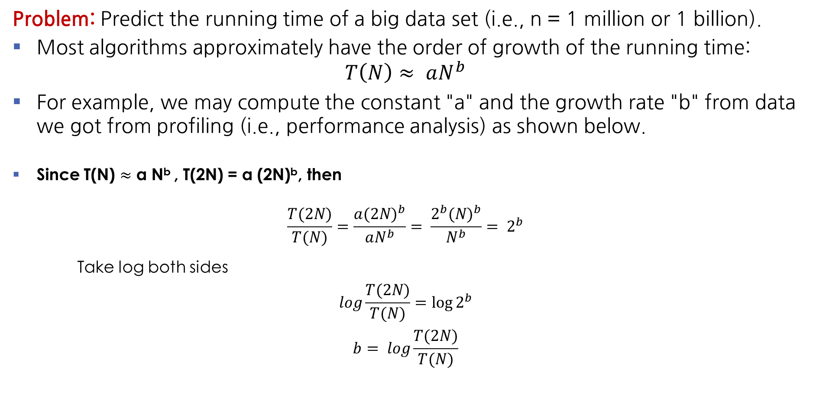
3 Profiling: Measuring Growth Rate
Problem: Predict the running time of a big data set (i.e., n = 1 million or 1 billion).
Most algorithms approximately have the order of growth of the running time: $T\left(N\right)≈ aN^{b}$
For example, we may compute the constant "a" and the growth rate "b" from data we got from profiling (i.e., performance analysis) as shown below.
Since T(N) $≈$ a N^{b} , T(2N) = a (2N)^{b}, then
$$\frac{T(2N)}{T(N)}=\frac{a{(2N)}^{b}}{aN^{b}}= \frac{{2^{b}(N)}^{b}}{N^{b}}= 2^{b}$$
Take log both sides
$$log\frac{T(2N)}{T(N)}=\log{2^{b}}$$
$$b= log\frac{T(2N)}{T(N)}$$

Slide 23
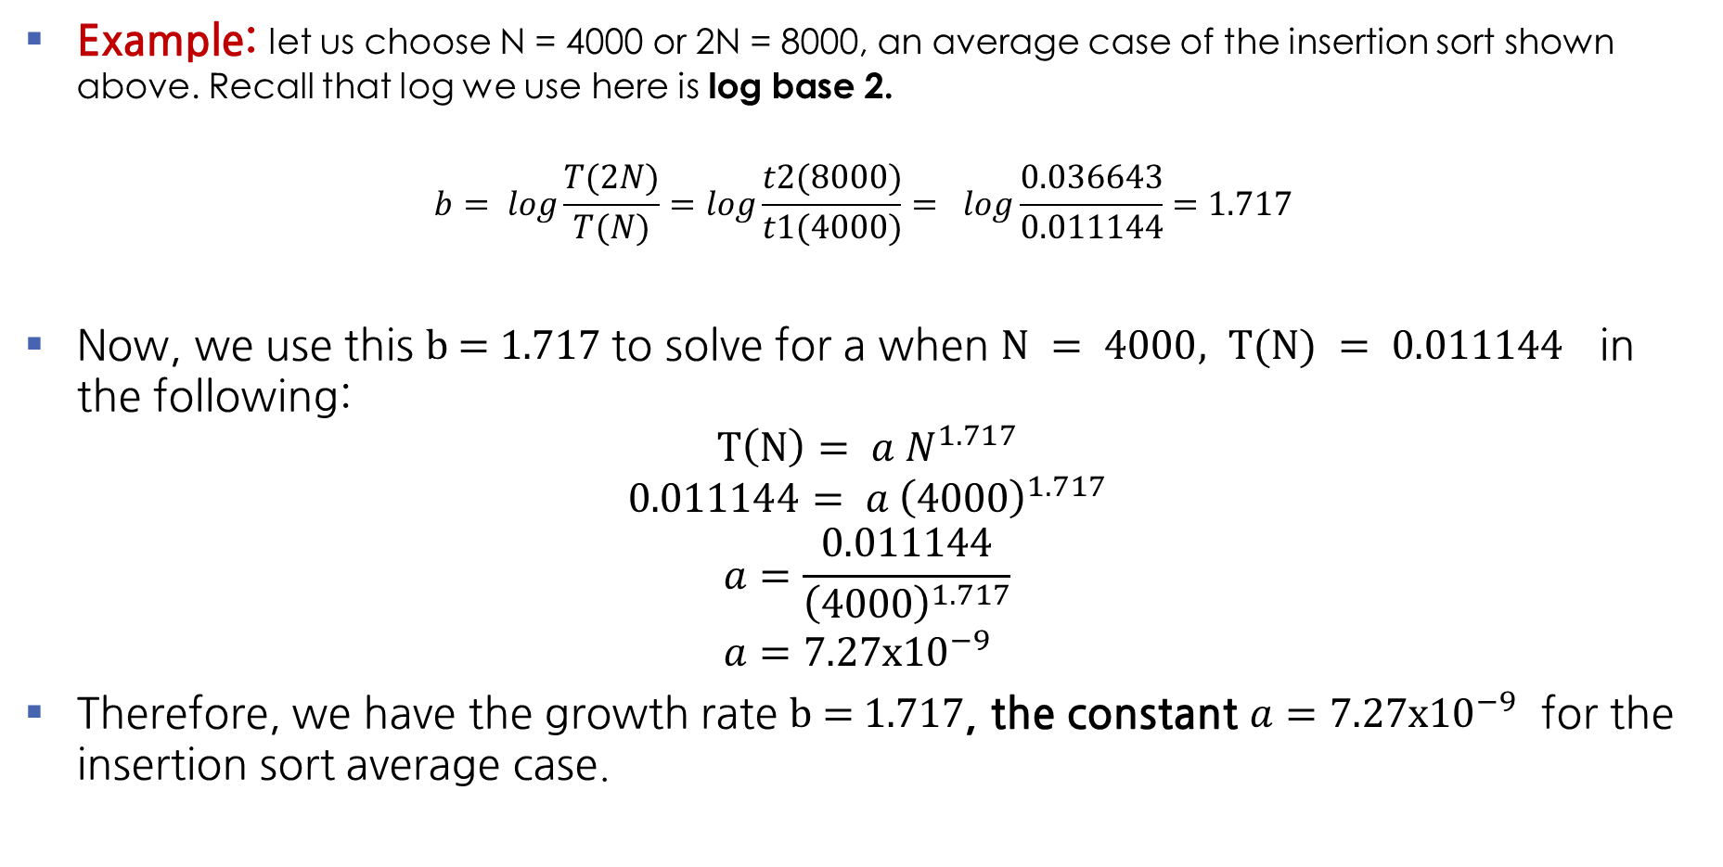
3 Profiling: Measuring Growth Rate - Example
Example: let us choose N = 4000 or 2N = 8000, an average case of the insertion sort shown above. Recall that log we use here is log base 2.
$$b= log\frac{T(2N)}{T(N)}=log\frac{t2(8000)}{t1(4000)}= log\frac{0.036643}{0.011144}=1.717$$
Now, we use this b = 1.717 to solve for a when $N = 4000, T(N) = 0.011144$ in the following:
$$T\left(N\right)= a N^{1.717}$$
$$0.011144= a {\left(4000\right)}^{1.717}$$
$$a=\frac{0.011144}{{\left(4000\right)}^{1.717}} \\ a=7.27x{10}^{−9}$$
Therefore, we have the growth rate b = 1.717, the constant $a=7.27x{10}^{−9}$ for the insertion sort average case.

Slide 24
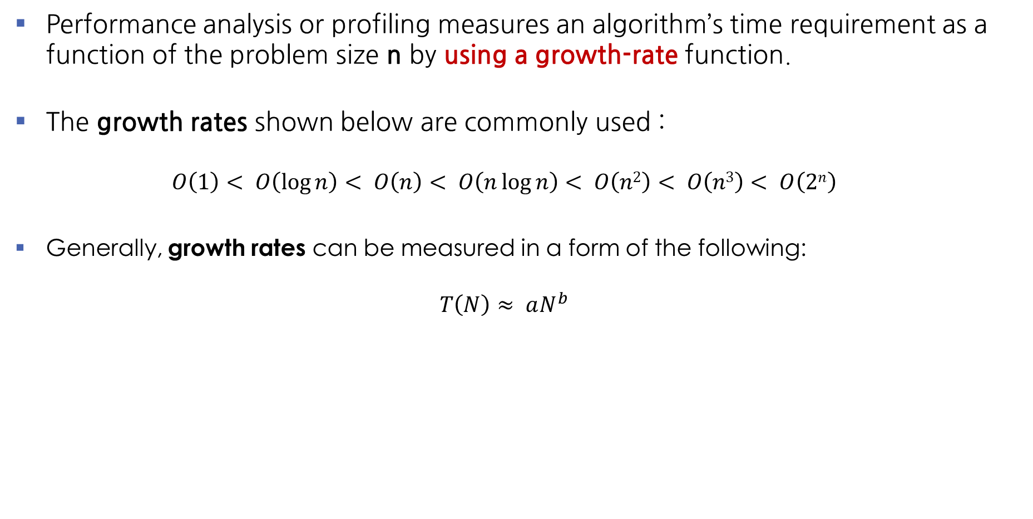
Summary
Performance analysis or profiling measures an algorithm’s time requirement as a function of the problem size n by using a growth-rate function.
The growth rates shown below are commonly used : $O\left(1\right)< O\left(\log{n}\right)< O\left(n\right)< O\left(n\log{n}\right)< O\left(n2\right)< O\left(n3\right)< O\left(2n\right)$
Generally, growth rates can be measured in a form of the following: $T\left(N\right)≈ aN^{b}$

Slide 25
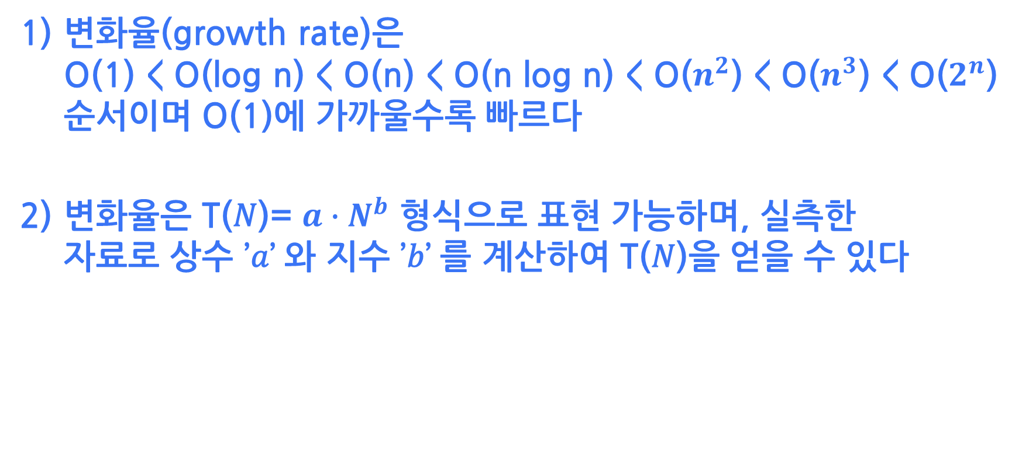
변화율(growth rate)은 O(1) < O(log n) < O(n) < O(n log n) < O($n^{2}$) < O($n^{3}$) < O($2^{n}$) 순서이며 O(1)에 가까울수록 빠르다
변화율은 T(𝑁)= ${a∙N}^{b}$ 형식으로 표현 가능하며, 실측한 자료로 상수 ’𝑎’ 와 지수 ’𝑏’ 를 계산하여 T(𝑁)을 얻을 수 있다

